Slide 1
Natural Language Processing City of Los Angeles Job Descriptions

Slide 2
Choose a job you love, and you will never have to work a day in your life
- Confucius

Slide 3

HELLO!
Meet Our Team
Joseph Yon
Xavier De La Rosa
Musafiri Kayambi

Slide 4
OBJECTIVES
Help the City of Los Angeles to Structure and Analyze its Job Descriptions Using Natural Language Processing
The City of Los Angeles faces a big hiring challenge:
1/3 of its 50,000 workers are eligible to retire by July of 2020
The city has partnered with Kaggle to create a competition to improve the job bulletins that will fill all those open positions
Kaggle Competition:
https://www.kaggle.com/c/data-science-for-good-city-of-los-angeles
Prize Money: $15,000

Slide 5
PROBLEM STATEMENT
The content, tone, and format of job bulletins can influence the quality of the applicant pool
Overly-specific job requirements may discourage diversity
The Los Angeles Mayor’s Office wants to reimagine the city’s job bulletins to identify needed improvements
The goal is to use a folder full (683 to be exact) of plain-text job postings then to use this data to:
Identify language that can negatively bias the pool of applicants;
Improve the diversity and quality of the applicant pool; and
Inform based on findings to update job listings

Slide 6
NLP Artificial Intelligence
Interactions between computers and human languages
Programming computers to process and analyze natural languages

Slide 7
Our Tools & Processes

Slide 8


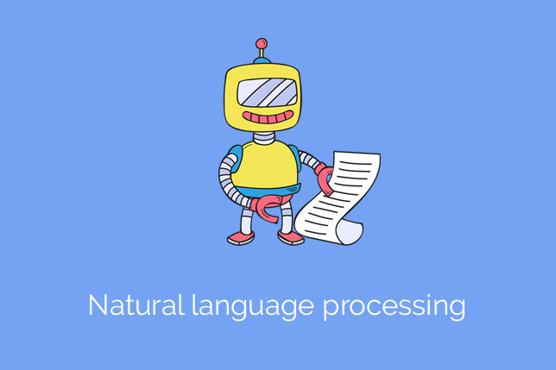
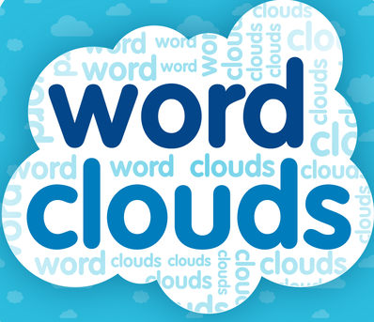

TOOLS

Slide 9
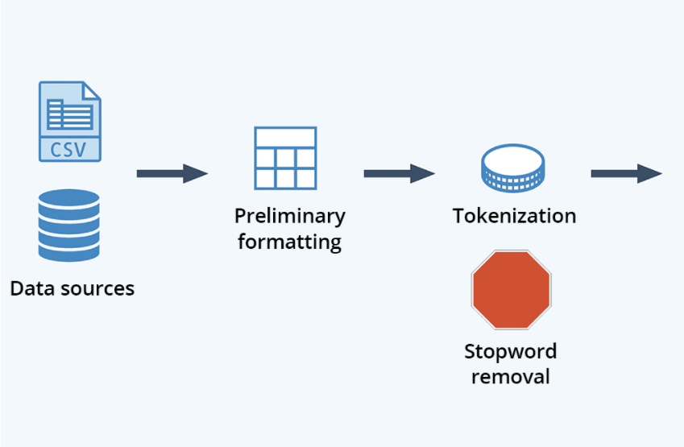

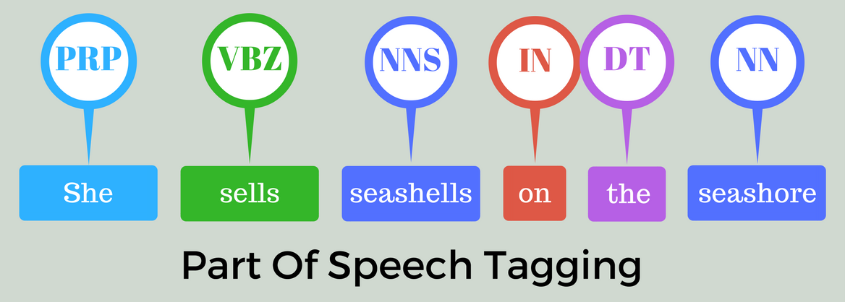
PROCESS I
Tokenize:
Break up strings into small structures/units to understand the importance of each word with respect to the sentence
Stop-Words:
Commonly used words (such as "and", "the", "a", "an", and similar words) that are irrelevant and have very little meaning
Regular Expressions:
Filter ReGex only and remove symbols and characters
POS Tagging:
Assigning tags to a single word according to its role in the sentence (i.e Verb, Noun, Adjective and etc.

Slide 10
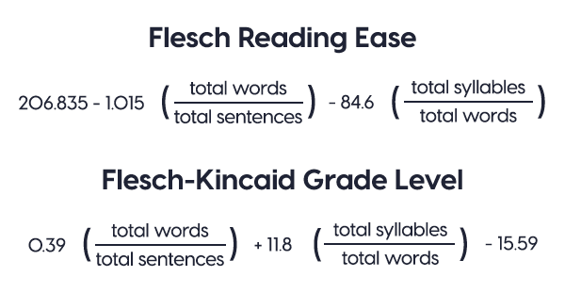
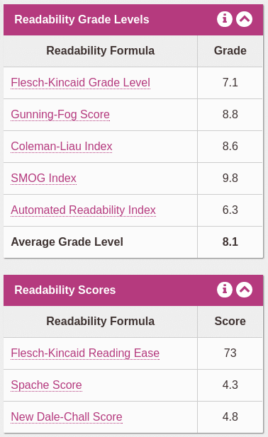
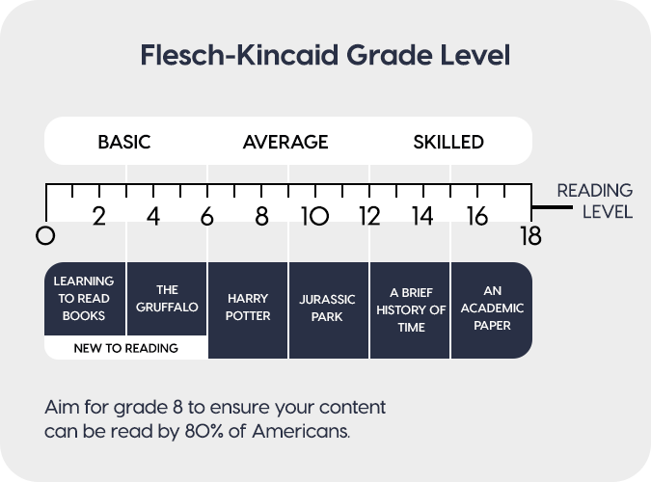
PROCESS II
Readability Index:
Readability is the ease with which a reader can understand a written text
In natural language, the readability of text depends on its content (the complexity of its vocabulary and syntax)
It focuses on the words we choose, and how we put them into sentences and paragraphs for the readers to comprehend

Slide 11
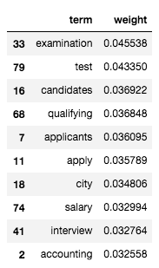
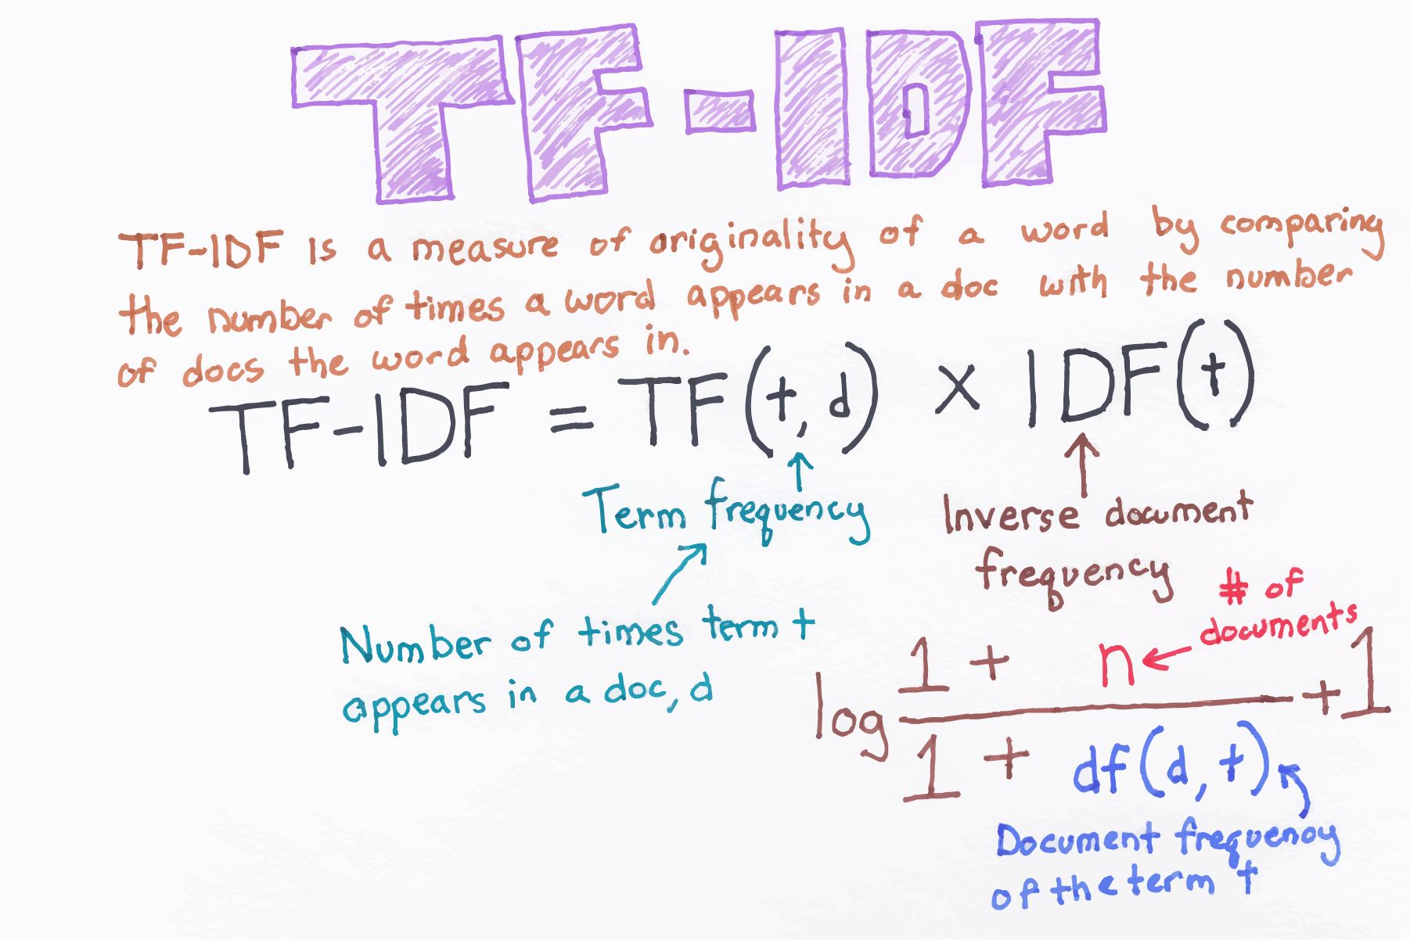
PROCESS III
TF-IDF (Term Frequency-Inverse Document Frequency):
A technique to quantify a word in documents to determine the importance of the word in the document (corpus)
Works by increasing proportionally to the number of times a word appears in a document, but is offset by the number of documents that contain the word.
So, words that are common in every document, such as this, what, and if, rank low even though they may appear many times, since they don’t mean much to that document in particular

Slide 12
ROADBLOCKS
NLTK vs. SpaCy
We tried 2 different Natural Language Processors
NLTK
SpaCy
Many say SpaCy uses the latest and best algorithms , and has a higher performance
NLTK is a better string processing library that takes strings as input and returns strings or lists of strings as output
The Data
Size of the data killed Kernels multiple times when analyzing them as a whole
Cleaning/Pre-Processing the data was time consuming because of the amount of words, 1.18 million, and selecting the right words to analyze, such as: Nouns or Verbs or Adjectives and etc.
Decisions, Decisions
Once we had the data and started cleaning it, we then needed to decide how to use NLP in an effective way
After reading the Job Bulletins, the problems were obvious, but how can we show that conclusively with the data and NLP

Slide 13

HERE’S SOME OF OUR WORK
The ultimate objective of NLP is to read, decipher, understand, and make sense of human languages in a manner that is valuable

Slide 14
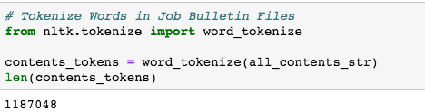
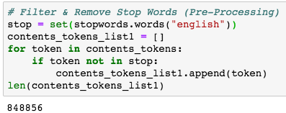
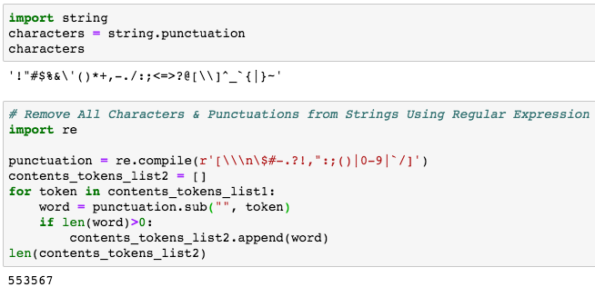
PYTHON – NLTK I

Slide 15
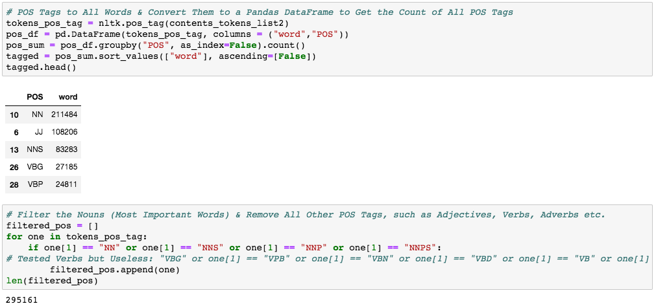
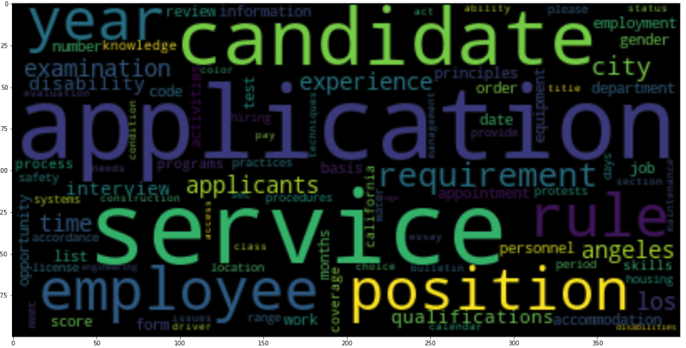
PYTHON – NLTK II

Slide 16
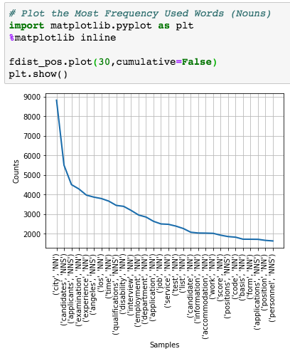
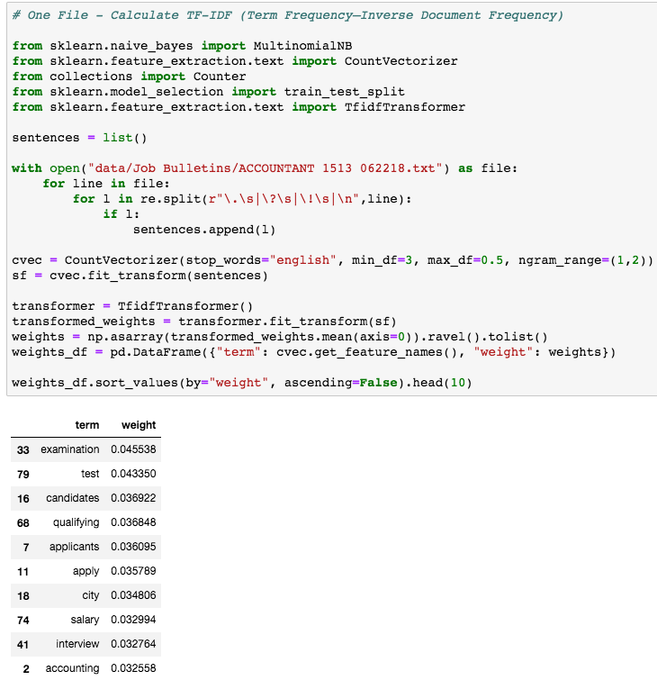
PYTHON – NLTK III
Frequency Distribution
(TF-IDF)
Term Frequency-Inverse Document Frequency

Slide 17
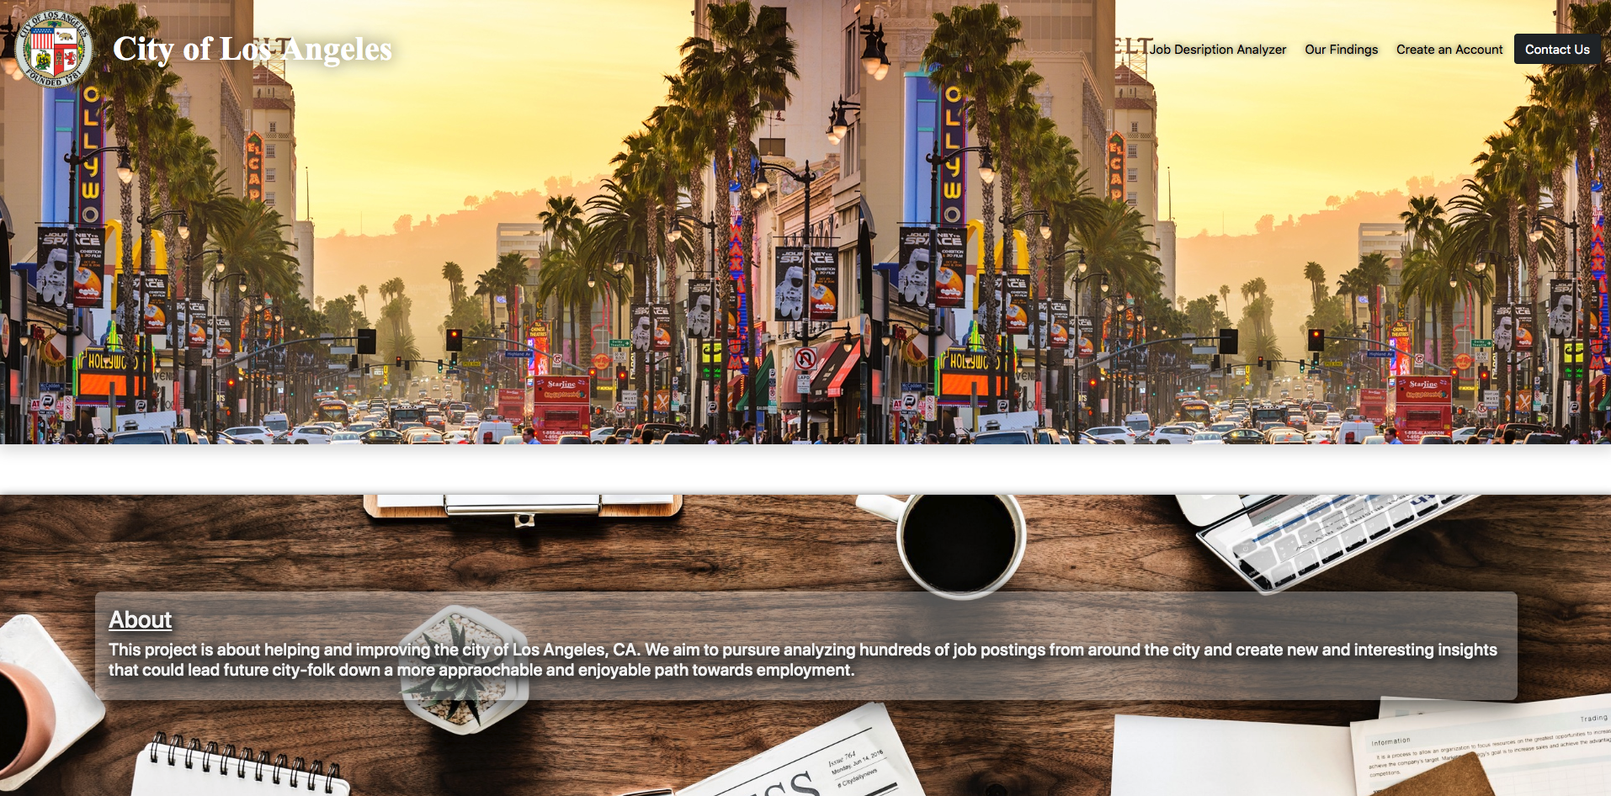
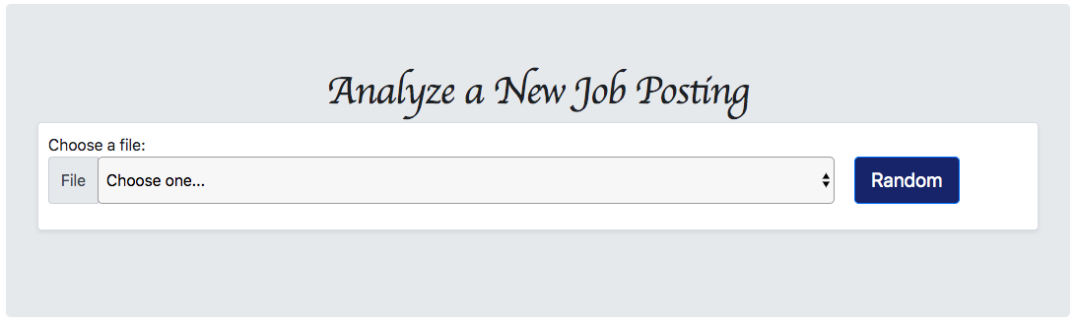
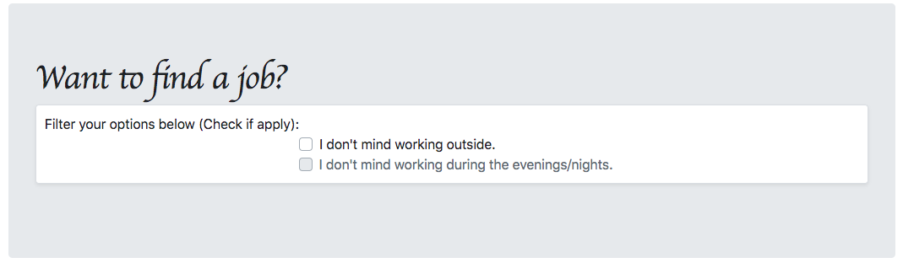
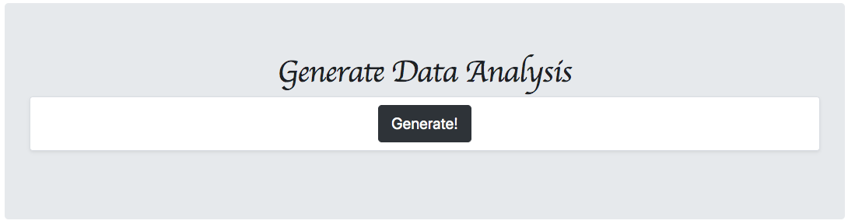
DASHBOARD

Slide 18
CONCLUSIONS
Word Counts
There are too many words per Job Bulletin at an average of 1200
Newer generations have shorter attention spans
Readability Indexes
Dale-Chall Readability Score:
Aver age Score 9.0 – 9.9
13th to 15th grade college student
Flesch Reading-Ease:
Average Score: 0-29
Very Confusing
TF-IDF
Most important words:
Examination
Test
Candidates
Qualifying
Not ideal words to attract candidates
Frequency of Words
The frequency of some words in the Job Bulletins could scare some candidates off:
ex: Examination

Slide 19
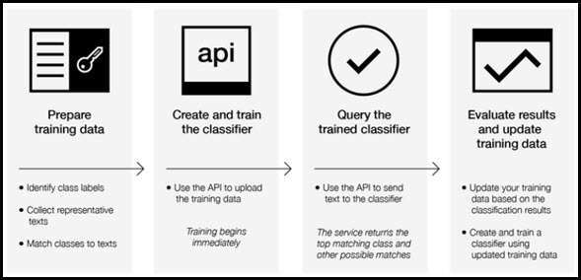
NEXT STEPS
Watson Natural Language Classifier :
Allow users to Classify Text into custom categories, at scale
Classify jobs further to ensure accuracy of descriptions, requirements and expectations
Combine various advanced ML techniques to provide the highest accuracy possible
Utilize multiple classification models, along with unsupervised and supervised learning techniques
Evaluate data against multiple Support Vector Machines (SVMs) and a Convolutional Neural Network (CNN) using IBM’s Deep Learning As a Service (DLaaS)

Slide 20

THANKS!

